Slide 1


Government funding & Sydney residential Aged Care business presentation
Is residential aged care a good business model?

Slide 2
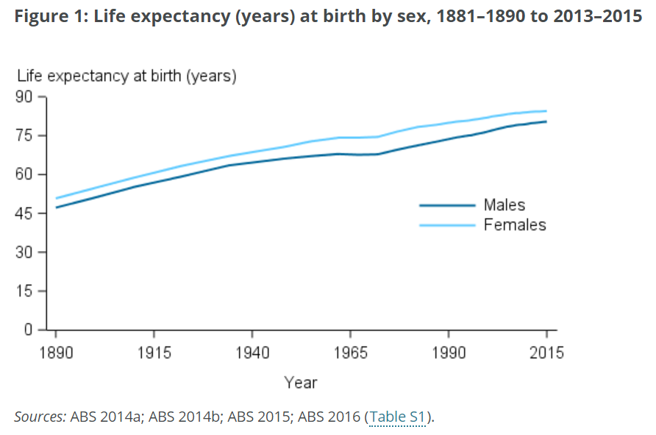
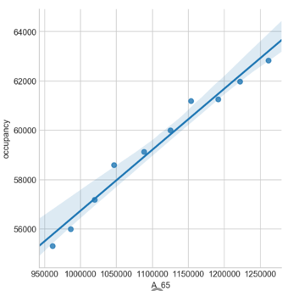
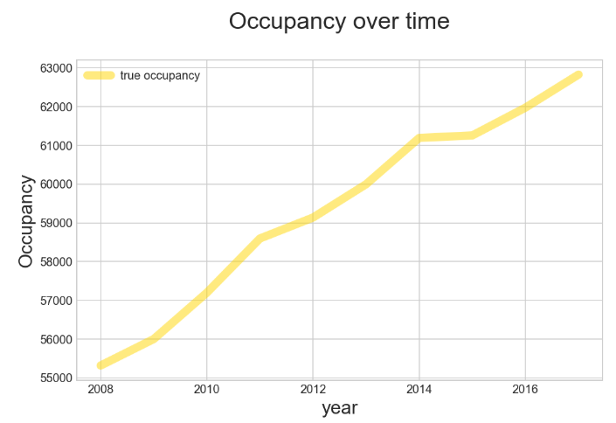
introduction
The Australian population is living longer due to better living conditions and medical breakthroughs.
The Australian bureau of statistics predicted that the Australian population will live past 80 years old
Hence the growth of residential aged care facilities

Slide 3
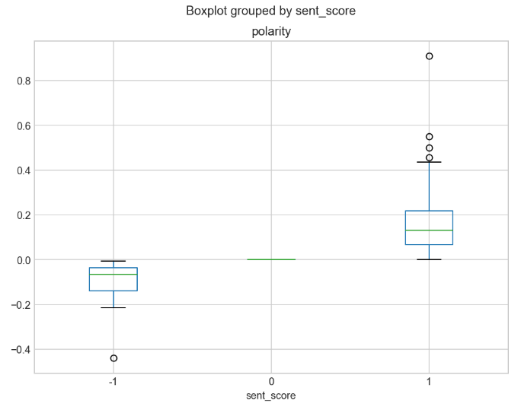




General sentiment on residential aged care
Positive
(67.42%)
Neutral
(8.33 %)
Negative
(24.24%)

Slide 4
WHAT INFLUENCES THE government funding?
DEFINE FUNDING LEVEL:
High
low
implied influencers:
residential/ places
distance to hospital
distance to beach
Models used
Logistic Regression (LR)
(97.45%)
K Nearest Neighbour (KNN)
(65.61%)
LR & GridSearch
(97.5%)
Support Vector Machine (SVM)
(97.5%)

Slide 5
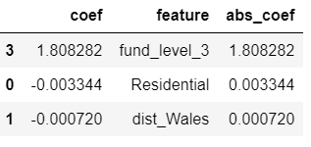

Is residential aged care a good business model?
There is demand
Based on sentiment, it is a practical decision
Number of residential places impacts financial government support
Location nearest to hospitals impacts financial government support
YES!
Prince of Wales Hospital (Ranwick)
(151.2387, -33.9190)

Slide 6
Limitations and risks
Data obtained were non granular and summarised
Many Assumptions on the data are already made
Reviews extracted from forums were moderately sufficient only
Reviews for specific residential aged care are not comprehensive
There are other influencing factors that have not been identified
The findings might be negatively impacted due to other unidentified influencing factors

Slide 7
Next steps
Determine if location affluence and private individual cost of entering a residential aged care impacts government funding received
Sentiments on individual residential aged care facility

